Slide 1
Exploring Hyperspace
Hobson Lane
hobs@totalgood.com
Notes:
How many of you are interested in learning about ML and AI?
What about database indexing or python data structures?
What about just python tools and packages?

Slide 2
What is High-D?
10-D
Physics breaks (string theory = 12D)
My mind breaks
Fails
Bounding boxes are useless (empty or full)
Indexing
Locality-sentiive hashes
<number>

Slide 3
Examples
Images
Time Series
Natural Language
<number>

Slide 4
Mental Gymnastics
"Imagine a 3D space and then say 12 dimensions to yourself forcefully over and over again."
Geoffrey Hinton
“Imagine a 3D sphere at the edge of universe, your vectors are out there.”
Anonymous
<number>

Slide 5
Why Squash?
Feature Extraction
Abstraction
Dimension Reduction
Generalization
Stereotyping?
<number>
Notes:
Basic features you might extract are things like number of spammy words
number of articles and conjuctions and other markers for “formality”
But semantic features are things like topics, sometimes not human understandable
and sometimes a dimension is a spectrum of topics across threads (TSNE)

Slide 6
"Issues" for AI
Features are far from each other
Features on a thin shell
Manifolds have many saddle points
Costs have local minima (though fewer than saddles)
Classes far away in feature space
<number>

Slide 7
Indexes? Hash tables? Trees?
Great for discrete or sparse vectors
[1 2 3 1 1 2 3 4 1 2 1 3 4]
[42 0 0 3 0 9 0 0 12 0 1 0 0]
[“A” 0 0 0 0 0 0 0 0 “and” 0 0 0 0 0 0 0 0 “cat”]
[0.123 0 0 0 0 0 0.567 0 0 0 0 -.42 0 0 0 2.718 0 0 0]
Bad for dense, real-valued vectors
[0.123 0.456 0.789 -0.1011 …]
<number>

Slide 8
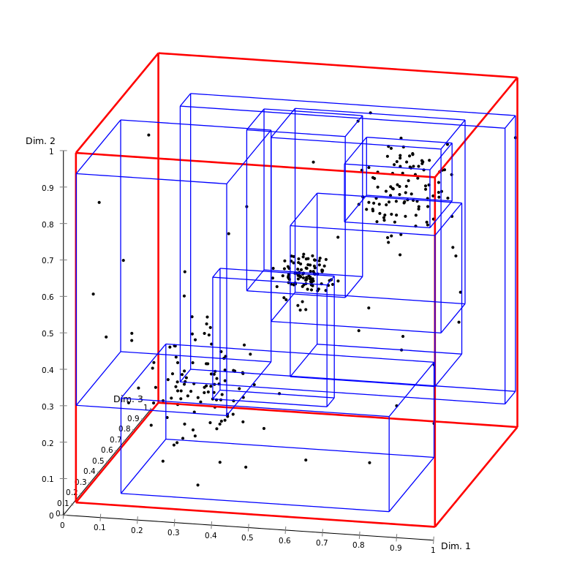
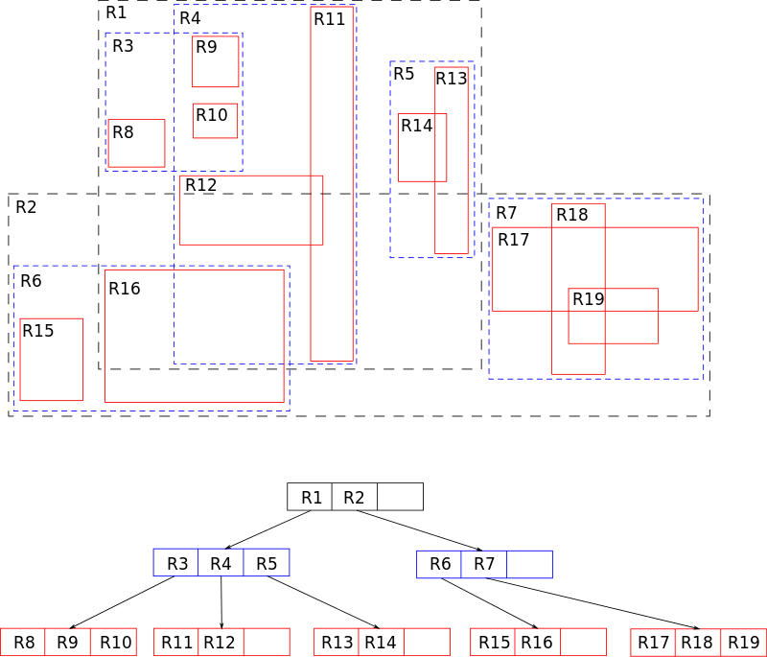
R-Tree (PostGIS)
Wikimedia Creative Commons
Wikimedia Creative Commons
<number>
Notes:
R-Trees are nested bounding boxes
They share a lot of the same boundaries
You can see how this gets harder as you increase dimensions and your data has “structure.”

Slide 9
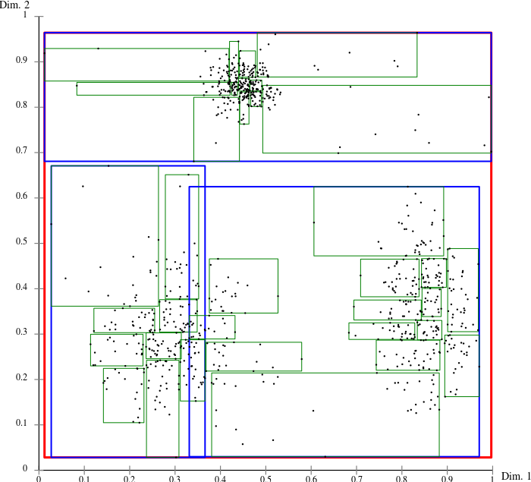
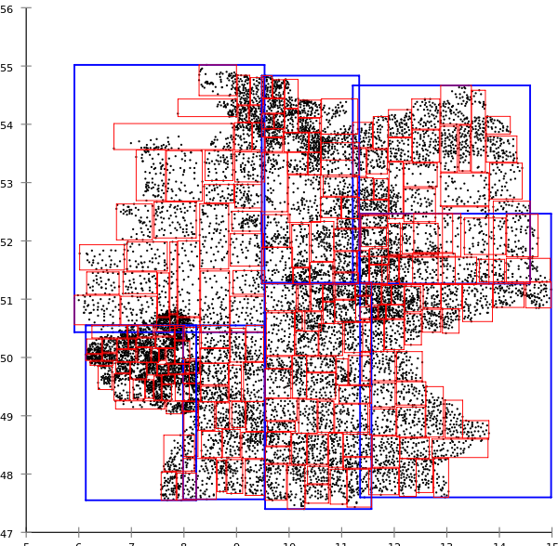
R*-Tree
Wikimedia Creative Commons
Wikimedia Creative Commons
<number>
Notes:
R*-Trees do a lot of pruning and optimizing and do well out to 50 dimensions (postgres)
But, it’s still just bounding boxes, and they are aligned with the axes/dimensions

Slide 10
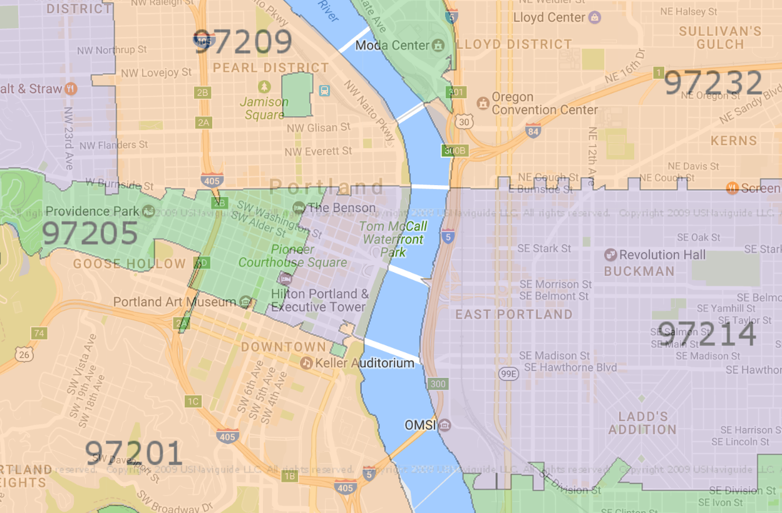
Hashes (dict)
Constant time lookup
Pseudorandom (no “distance”)
Locality-Sensitive Hashes?
Zip Codes work in 2-D, right?
<number>

Slide 11
Semantic Search Index
pip install lshash3
D | N | 100th Cosine Distance | Top 1 Correct | Top 2 Correct | Top 10 Correct | Top 100 Correct
2 | 4254 | 0 | TRUE | TRUE | TRUE | TRUE
3 | 7727 | 0.0003 | TRUE | TRUE | TRUE | TRUE
4 | 12198 | 0.0028 | TRUE | TRUE | TRUE | TRUE
5 | 9920 | 0.0143 | TRUE | TRUE | TRUE | TRUE
6 | 11310 | 0.0166 | TRUE | TRUE | TRUE | TRUE
7 | 12002 | 0.0246 | TRUE | TRUE | TRUE | FALSE
8 | 11859 | 0.0334 | TRUE | TRUE | TRUE | FALSE
9 | 6958 | 0.0378 | TRUE | TRUE | TRUE | FALSE
10 | 5196 | 0.0513 | TRUE | TRUE | FALSE | FALSE
11 | 3019 | 0.0695 | TRUE | TRUE | TRUE | FALSE
12 | 12263 | 0.0606 | TRUE | TRUE | FALSE | FALSE
13 | 1562 | 0.0871 | TRUE | TRUE | FALSE | FALSE
14 | 733 | 0.1379 | TRUE | FALSE | FALSE | FALSE
15 | 6350 | 0.1375 | TRUE | TRUE | FALSE | FALSE
16 | 10980 | 0.0942 | TRUE | TRUE | FALSE | FALSE
<number>

Slide 12
Variance Maximizing D-Reducers
PCA: Principal Component Analysis
LSI: Latent Semantic Indexing
LSA: Latent Semantic Analysis
SVD: Singular Value Decomposition
One way to "squash" our hyperspace would be to "lemmatize" LSI, LSA, SVD, and PCA together, eliminating 12 dimensions
<number>
Notes:
Attempt interactive playdough “demonstration” having audience build coffeee mugs or other 3D objects and then flattening them along the direction they think will preserve as much of the information/structure as possible. Can you still see the hole in the coffee mug handle? The “hollowness” of the cup/bowl? What features are lost?

Slide 13
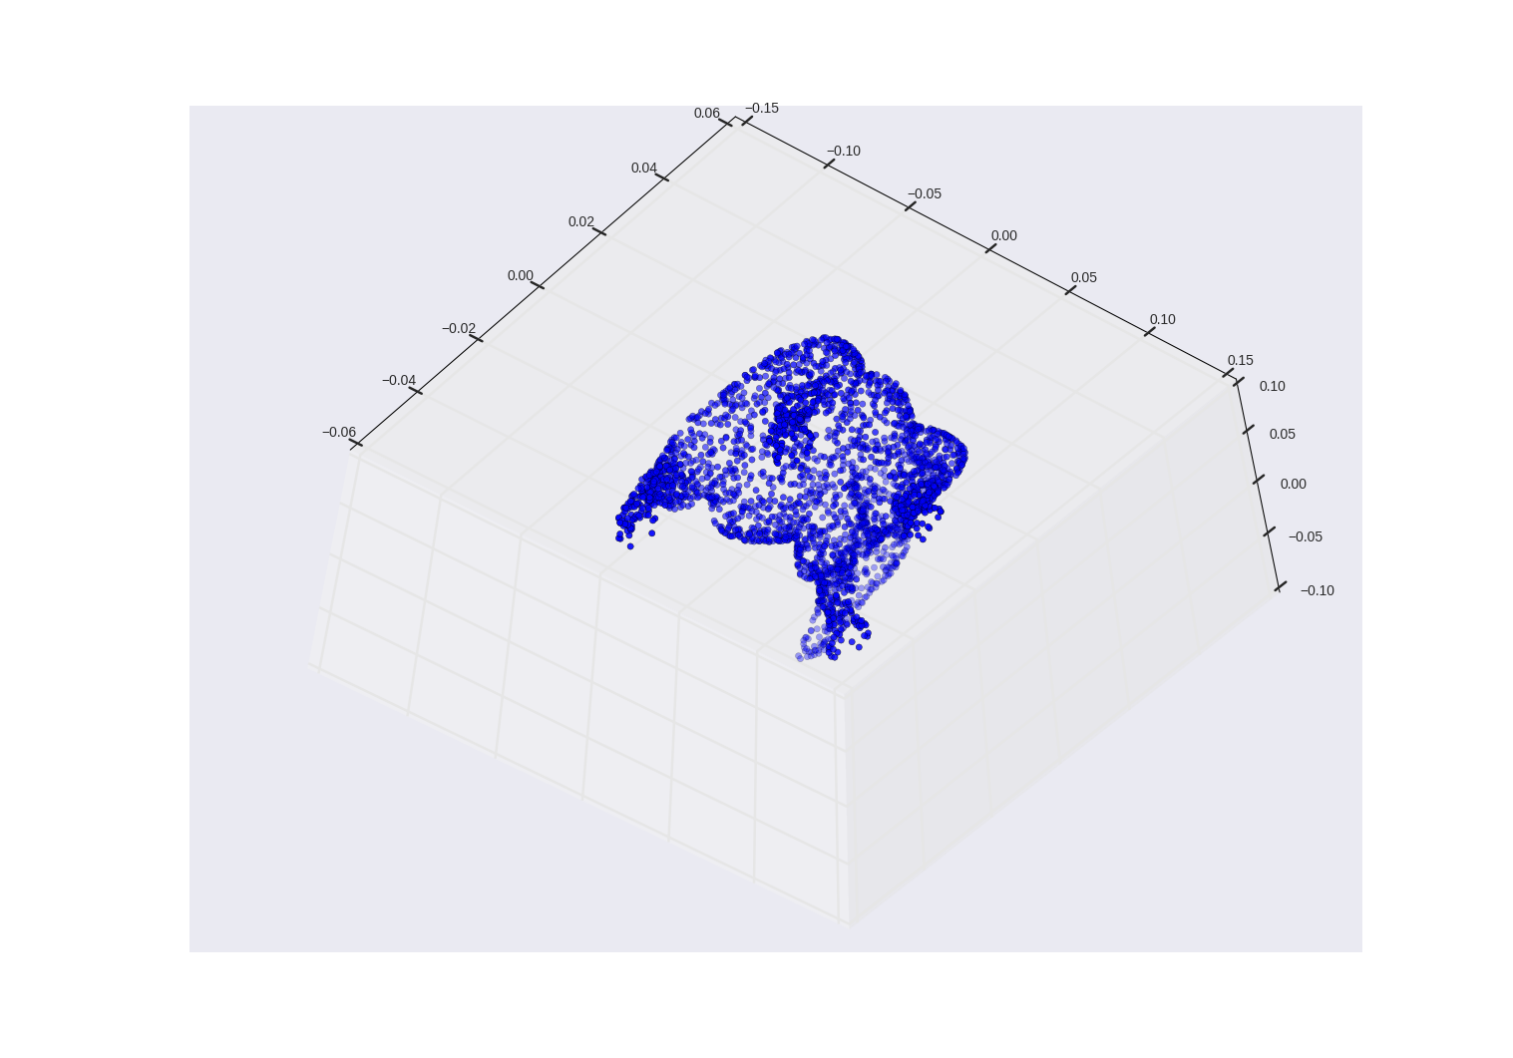
Some 3D Vectors
How useful is this 2D projection?
Image?
Document?
Time series?
Person, place, or thing?
<number>

Slide 14
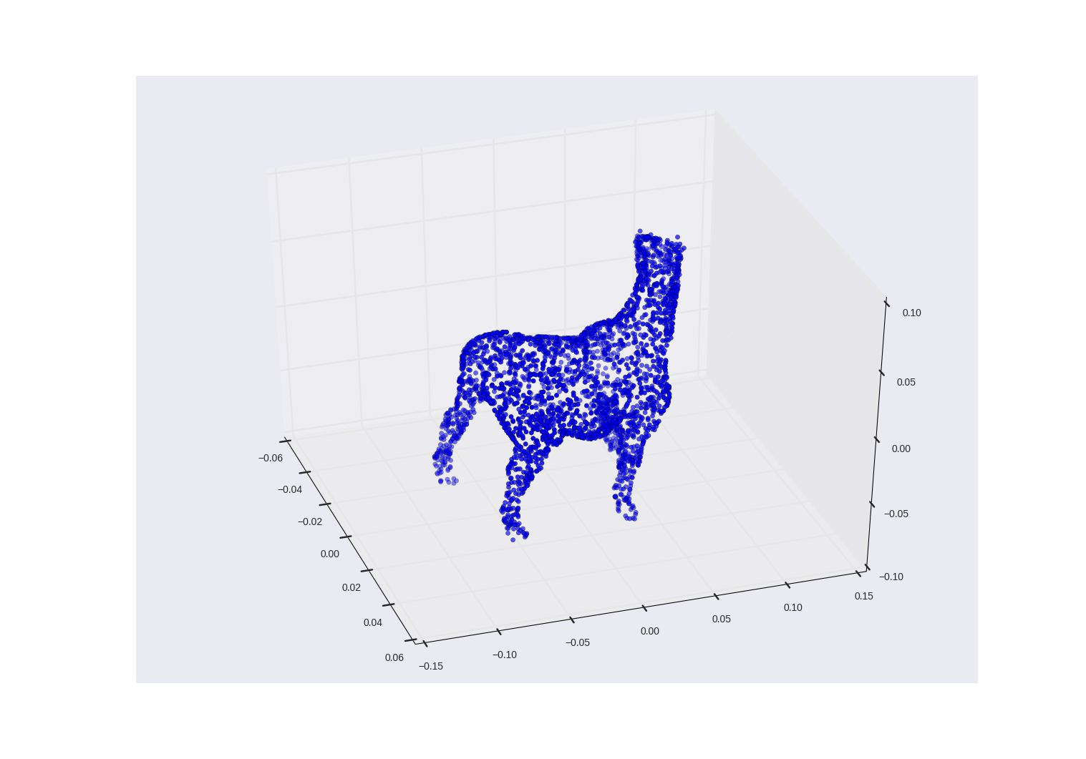
Better projection
<number>

Slide 15
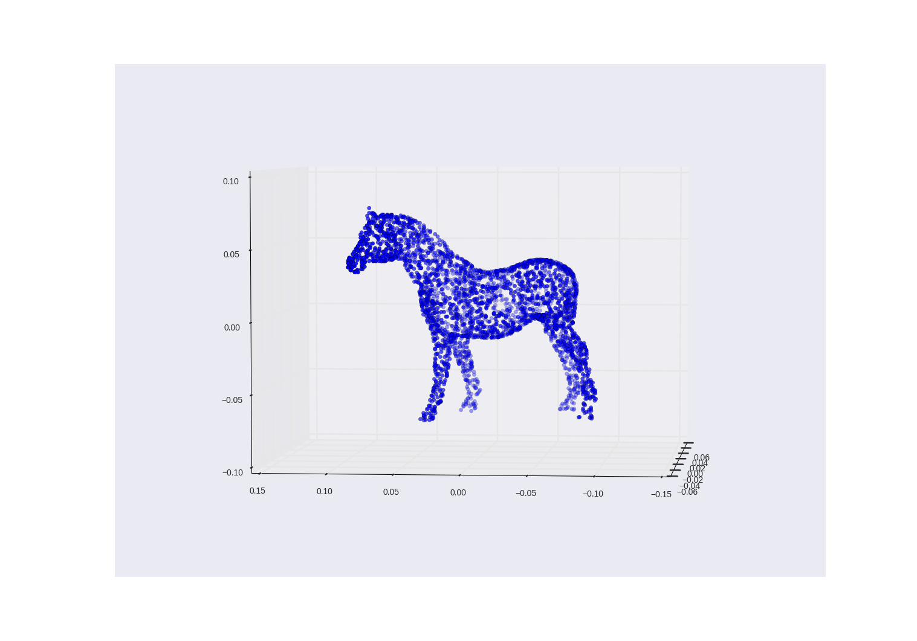
Better Projection
<number>

Slide 16
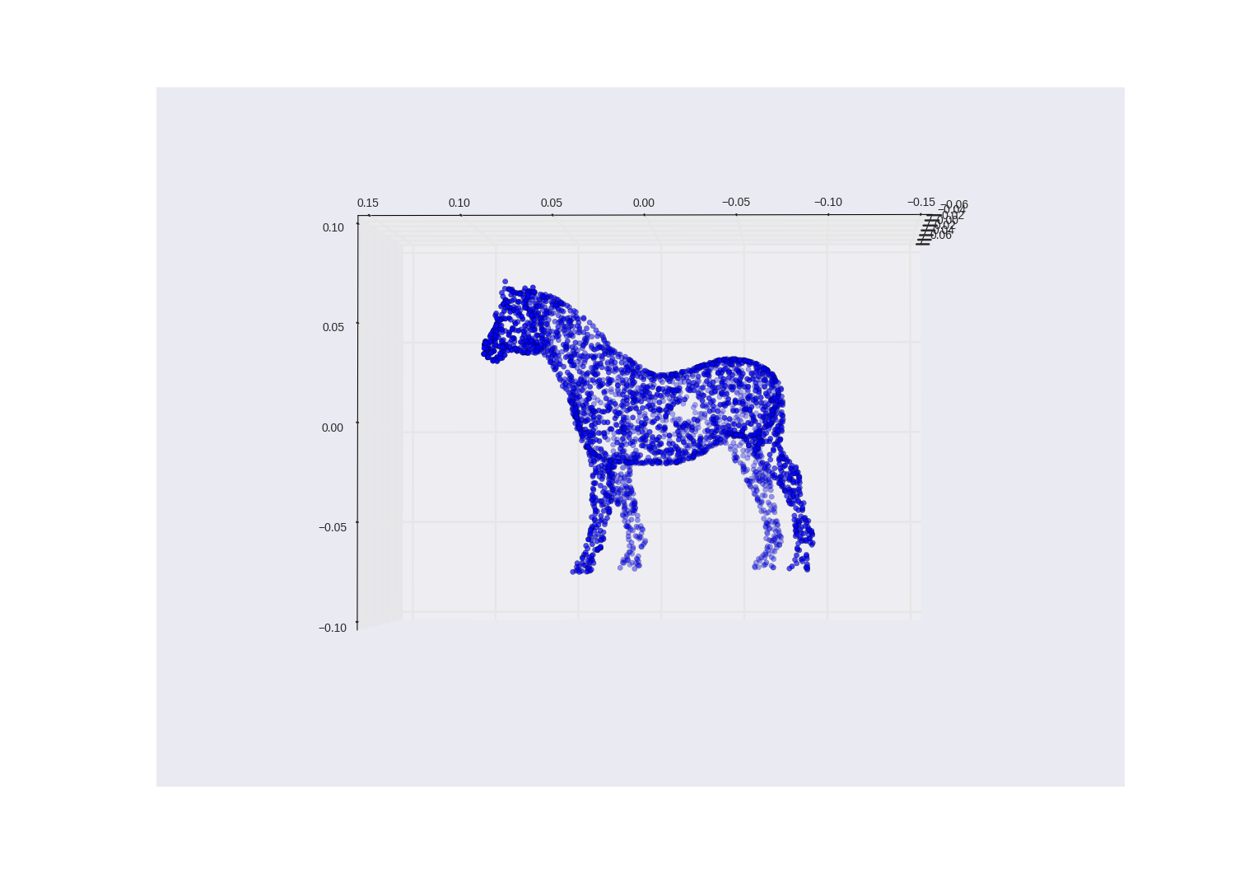
Best Projection by Human
<number>

Slide 17
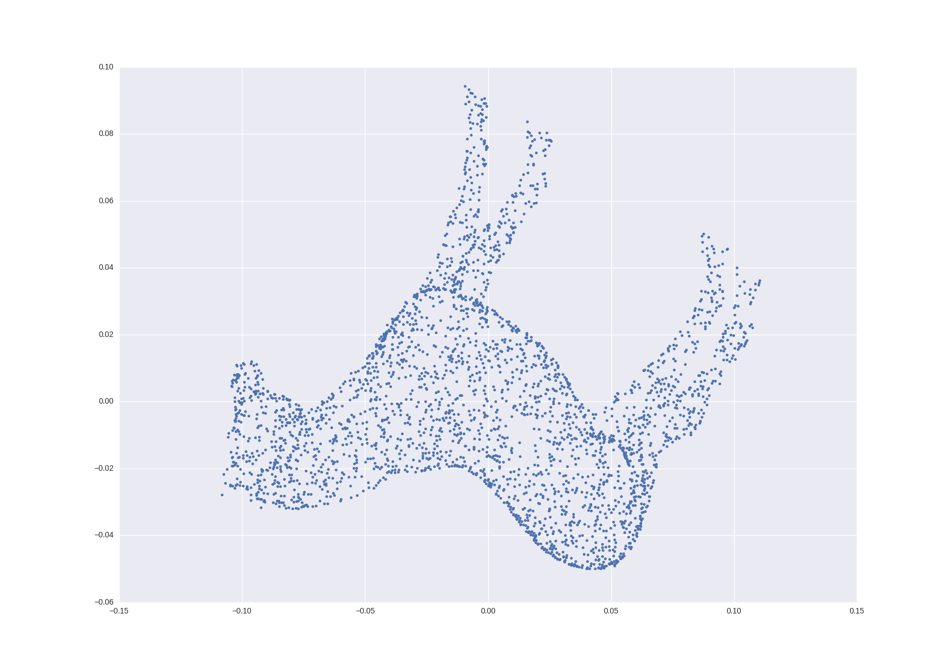
What PCA "sees"
>>> from sklearn.decomposition import PCA
>>> pca = PCA(n_components=2)
>>> horse_2d = pca.fit_transform(horse_3d)
>>> horse_2d
array([[ 0.05345299, -0.01176284],
[-0.04042495, 0.00867702],
[ 0.01822556, 0.06463228],
...,
[-0.09842423, -0.01486043],
[ 0.04317155, -0.01602001],
[-0.09122991, -0.02736549]])
Anomaly
Void
Outlier
<number>
Notes:
SVD (PCA) will rotate the 3D object until the “longest axis” (most variance) is along the X axis. 2nd-largest variance along Y.
SVD ensures that large variances and anomalies are preserved, but not necessarily fine-grained (small) structure (nostrils, mouth, hooves, tail, musculature, hair)

Slide 18
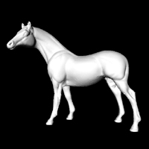
A Horse is a Horse unless...
Residual injection molding plastic?
… It’s Mr. Ed,
or a plastic toy on a 3D scanner.
Thank you Georgia Tech
<number>

Slide 19
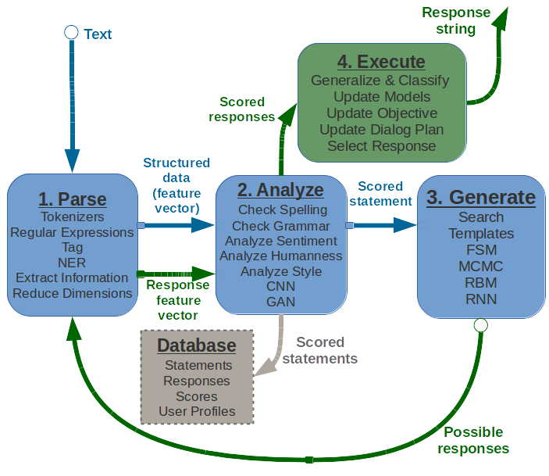
Recurrent Chatbot
<number>

Slide 20
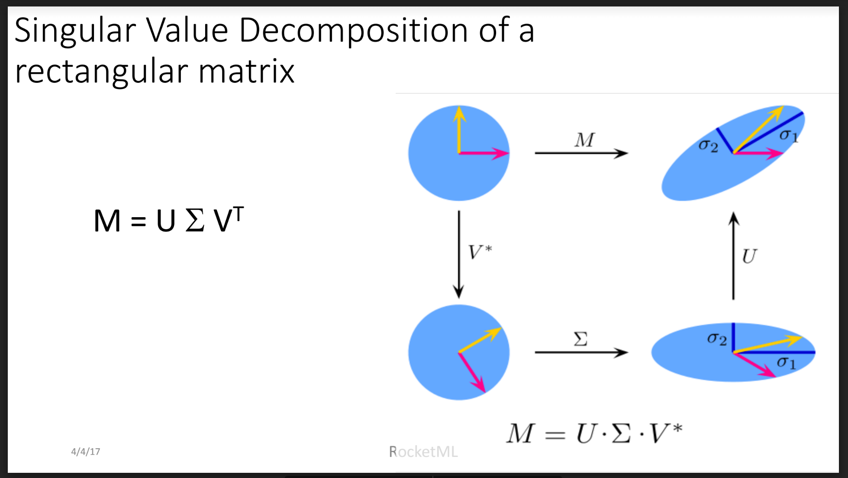
<number>

Slide 21
Open Spaces Twitter Bot
Bot streaming
Twitter
Spam/Troll Filter
Extract
Time & room
Compose & schedule tweets
DRF API
Manual approval
LSI Model
Celery
RabbitMq
Tweet with target word in text
Sends tweet
!
Tweets gathered from search API
<number>

Slide 22
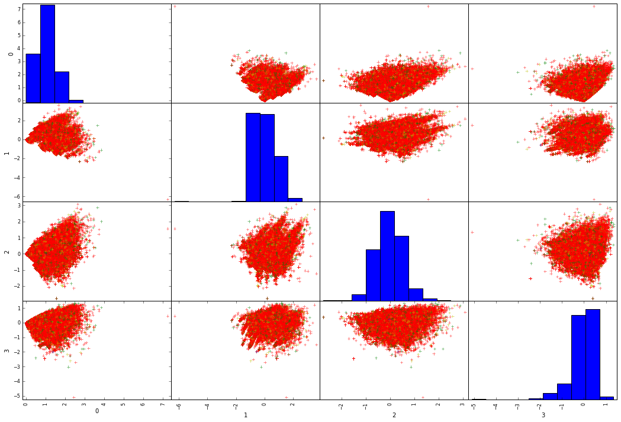
gensim.models.LsiModel
<number>
Notes:
Green dots are favorited tweets. Red dots are other tweets with zero favorites. This is the first 4 dimensions out of 200 (the dimensions with the highest variance)

Slide 23
PCA Generalizes Well
LSA on 5.5 M tweets
81.2% accuracy for 50 k bot/human tweet examples
79.6% accuracy for 3.3 k bot/human examples
Only 1.6% gain for 15x labeled data!
<number>
Notes:
Green dots are favorited tweets. Red dots are other tweets with zero favorites. This is the first 4 dimensions out of 200 (the dimensions with the highest variance)

Slide 24
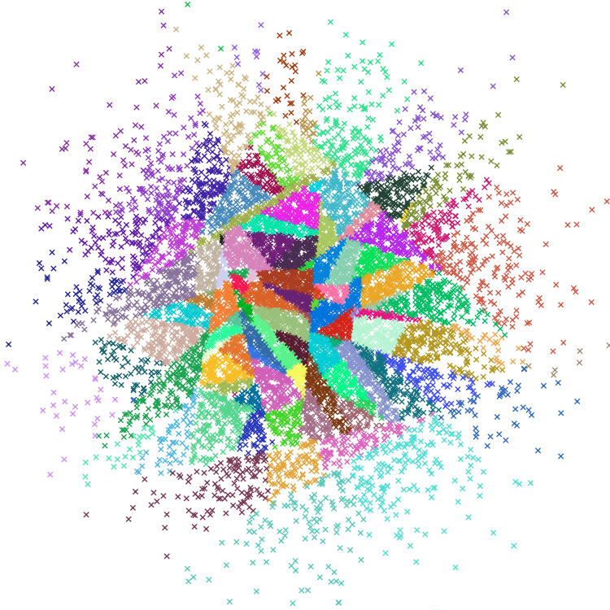
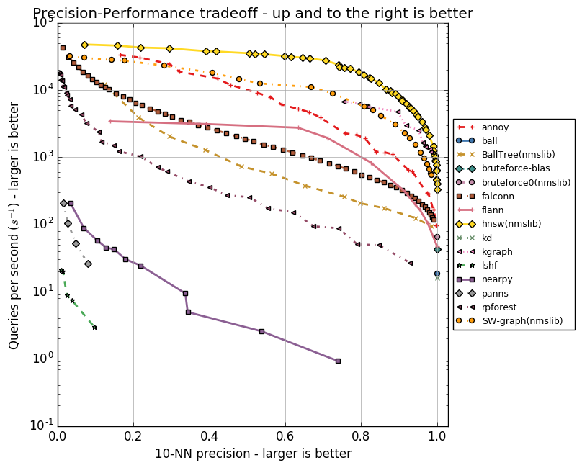
pip install annoy
<number>

Slide 25
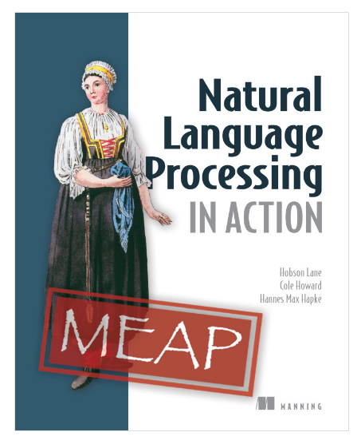
NLP in Action
NL Search
NL Modeling
NL Generation
CNNs, RNNs, and LSTMs
Word2Vec, GloVe
<number>

